Slide 1
Ford Car Price Prediction
Done By: Toh Kien Yu (2222291)

Slide 2
Table Of Content
Gitlab (Scrum Board and Branches)
Machine Learning Model
Web Application Development
Automatic Testing
Internet Deployment (Render)
Conclusion
Dataset: https://www.kaggle.com/datasets/adhurimquku/ford-car-price-prediction

Slide 3
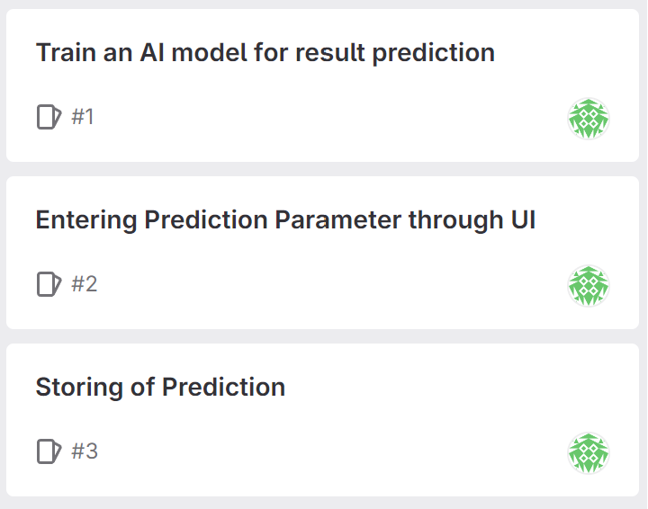
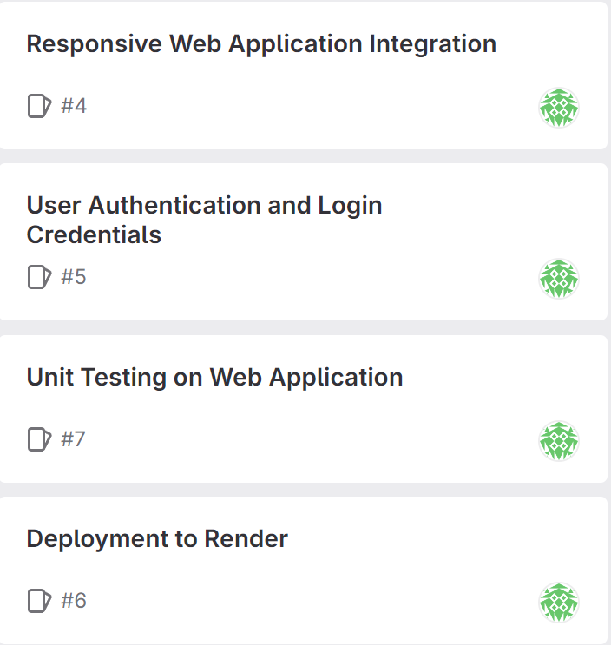
Scrum Board

Slide 4
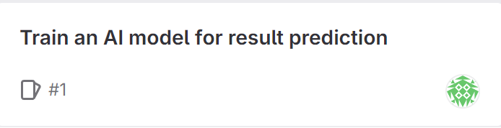
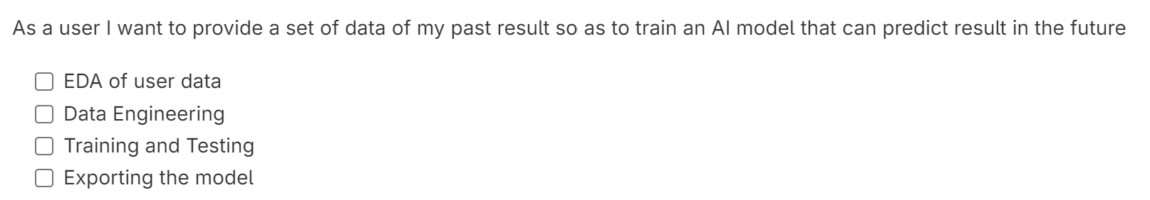
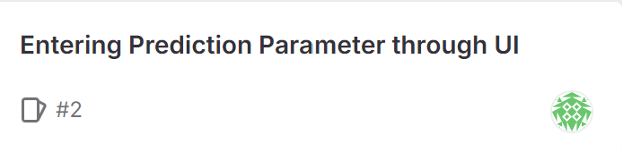
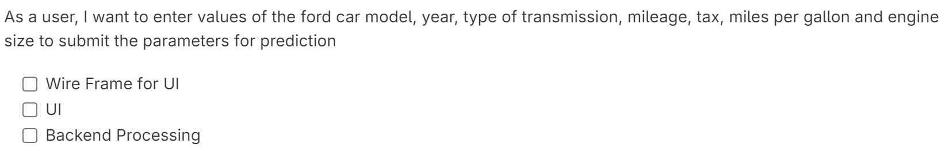
Scrum Board

Slide 5
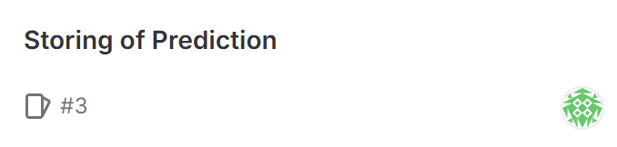

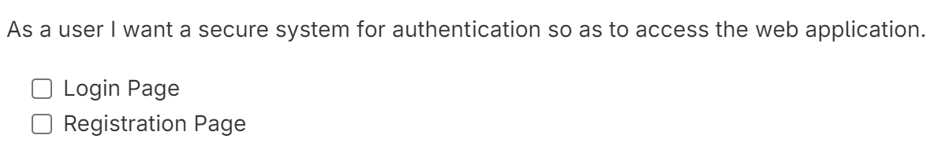
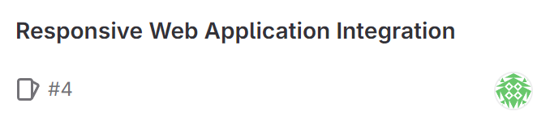
Scrum Board

Slide 6
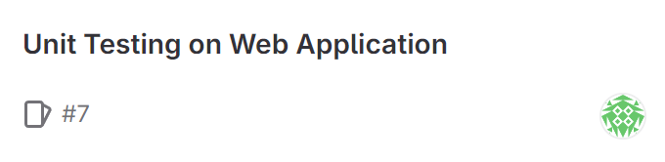
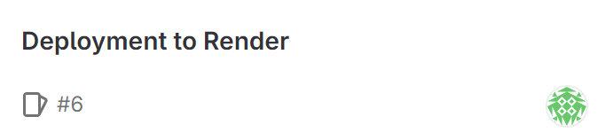
Scrum Board

Slide 7
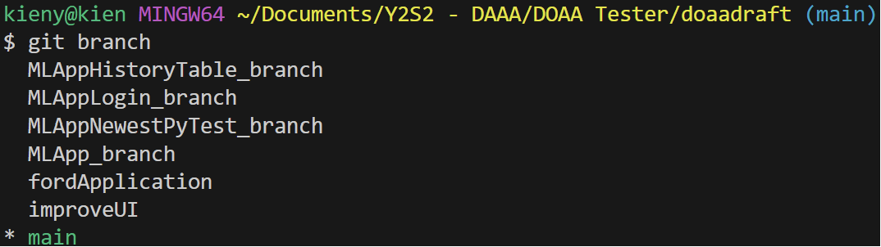
Branches
Branch 1: fordApplication
Training regression model for web application
Branch 2: MLAppDB_branch
Integrate regression model to web application
Entering prediction parameter through UI
Branch 3: MLAppHistoryTable_branch
Storing of prediction through a history table
Branch 4: MLAppLogin_branch
User Authentication and Login Credentials
Branch 5: improveUI
Responsive Web Application
Branch 6 MLAppNewestPyTest_branch
Unit Testing on Web Application

Slide 8
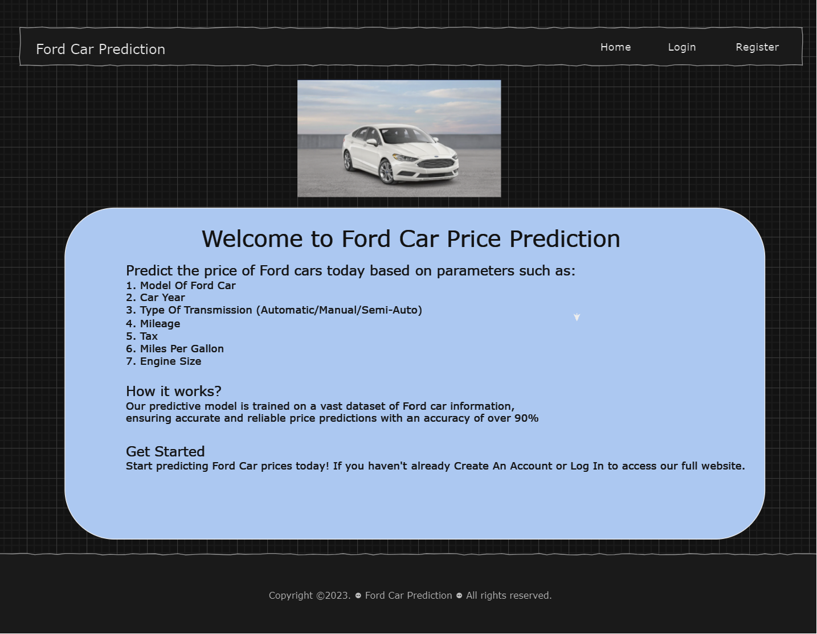
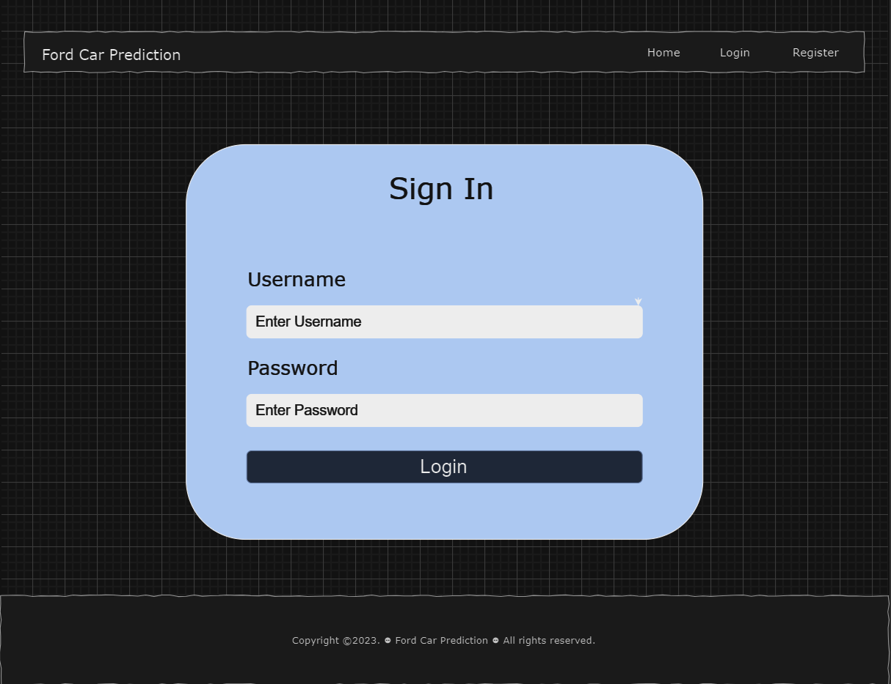
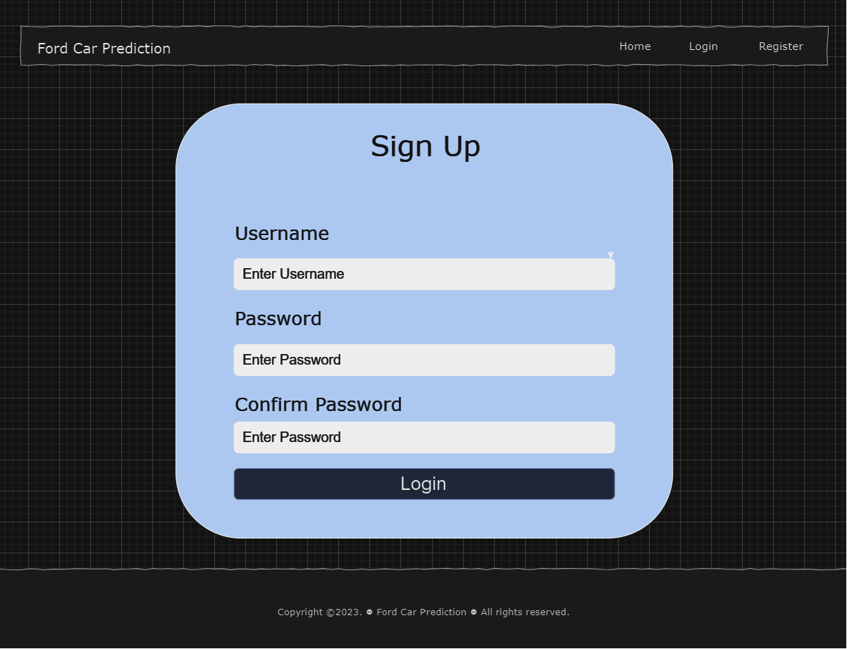
WireFrame
index.html
login.html
register.html

Slide 9
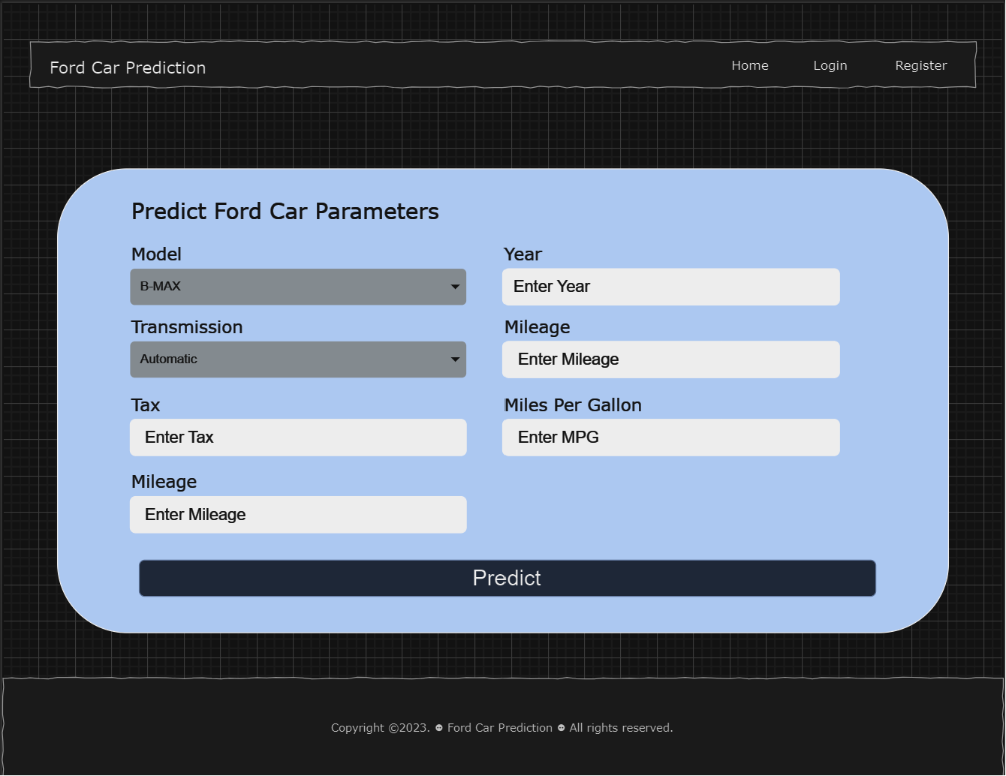
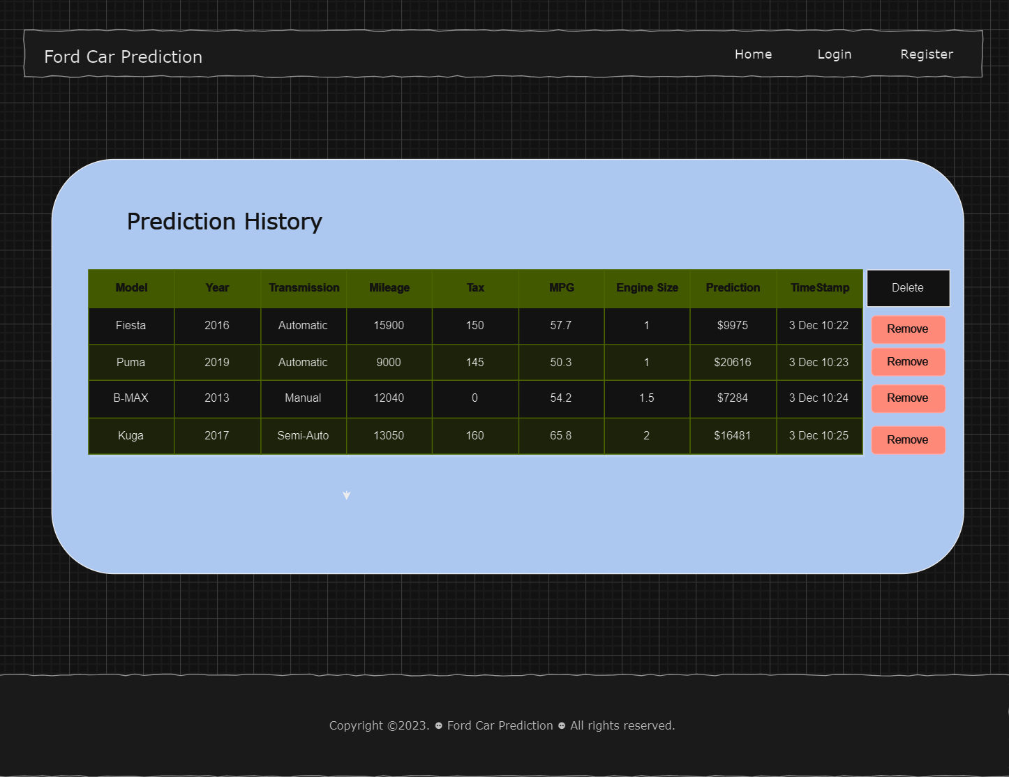
WireFrame
predictionForm.html
history.html

Slide 10
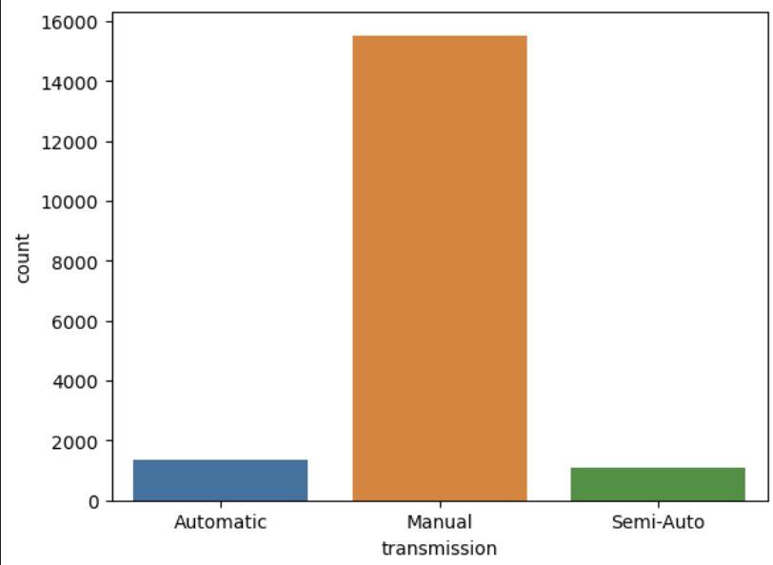
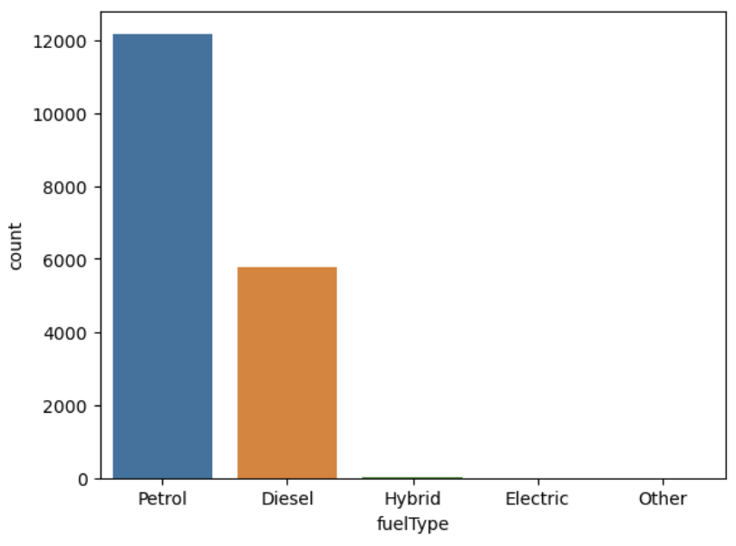
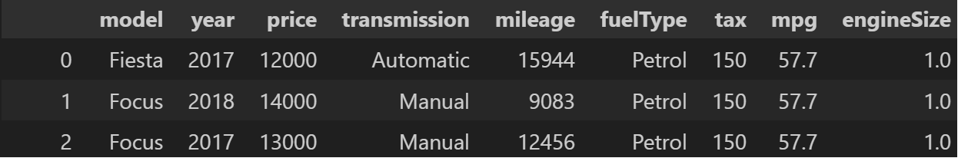
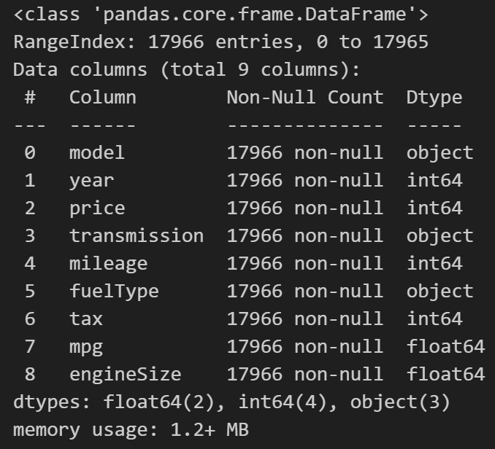
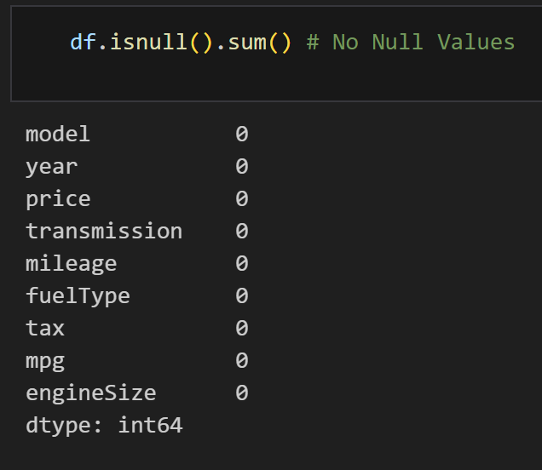
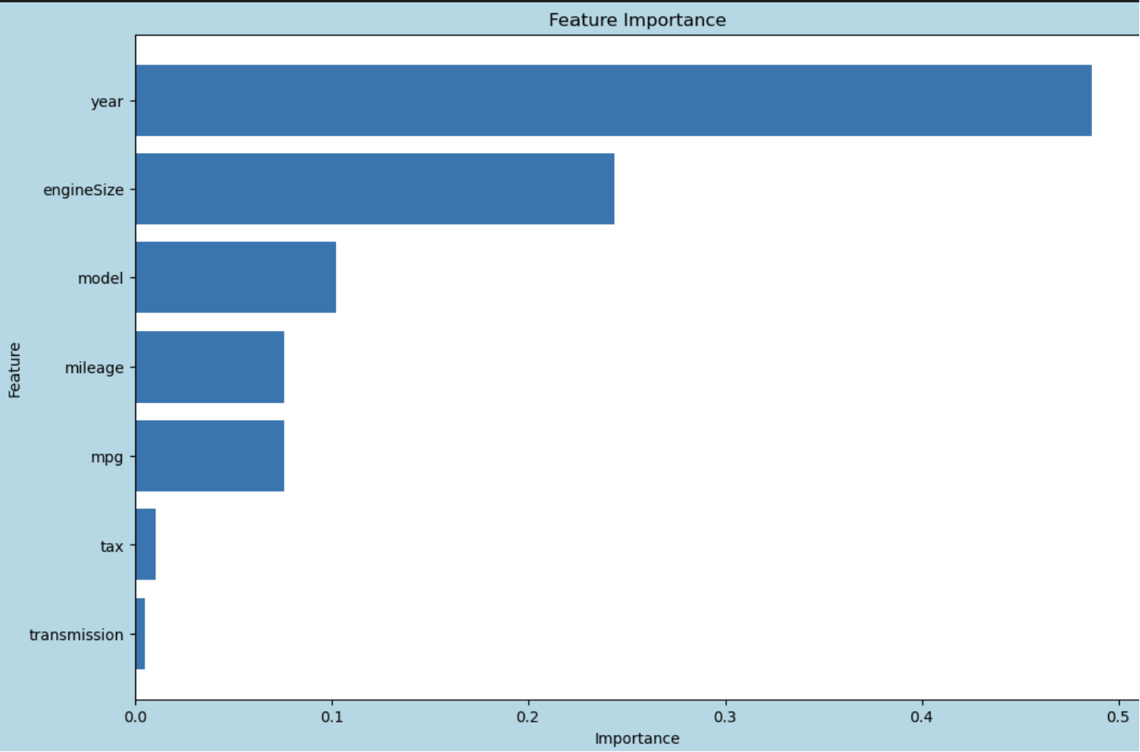
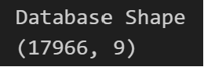
Branch 1 (fordApplication)
Exploratory Data Analysis
Nature of Dataset

Slide 11
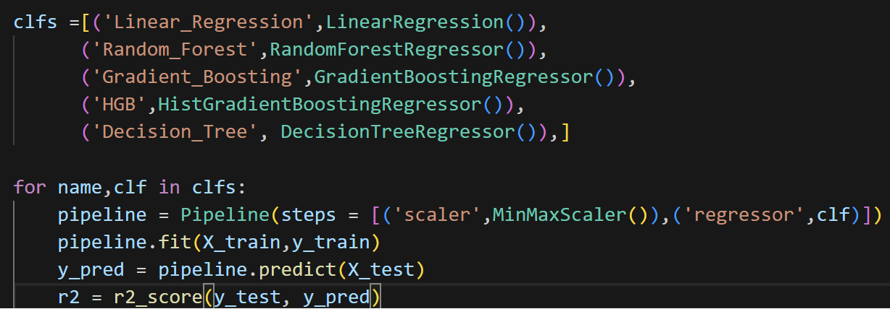
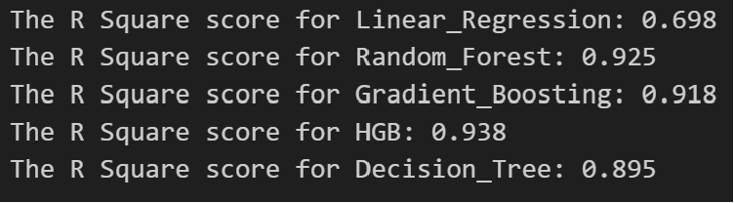
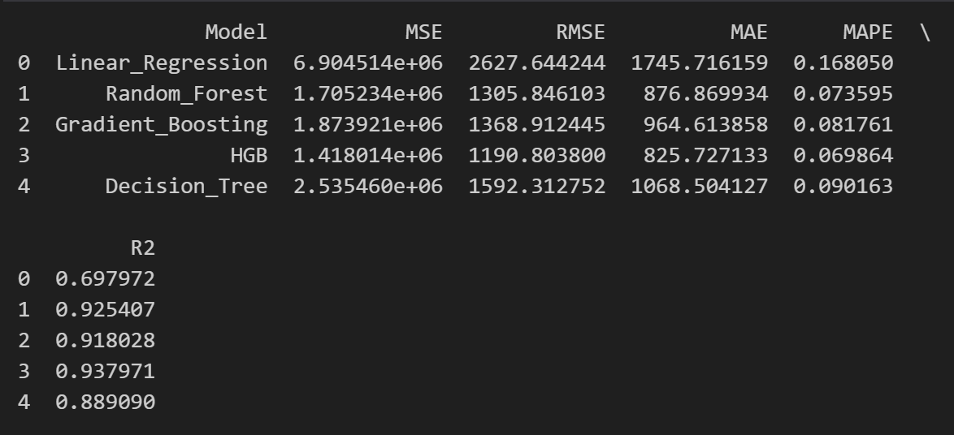
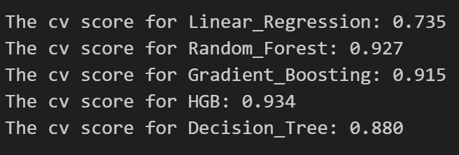
Branch 1 (fordApplication)
Modelling
Results

Slide 12
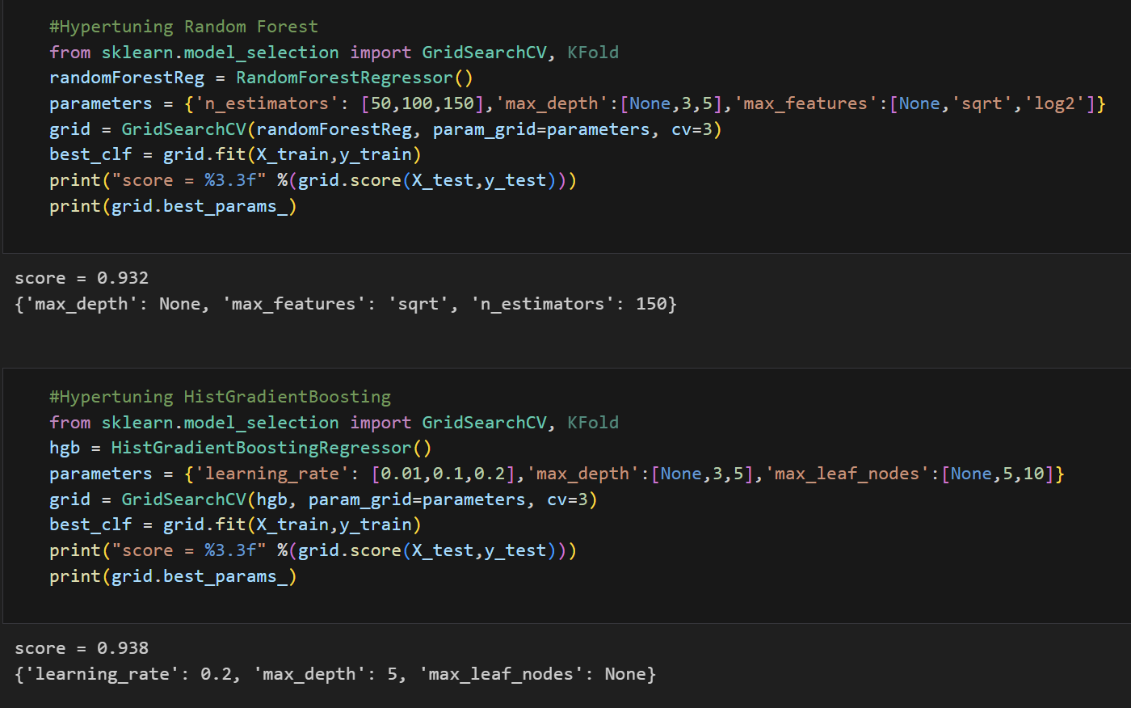
Branch 1 (fordApplication)
Hyper-parameter tuning
I Picked out 2 of the most accurate model to hyperparameter tune
Random Forest
HistGradientBoosting
Now, I will hyperparameter tune the model to further improve the accuracy by customizing the parameters for the algorithm.
Define a param grid for each model, and parameters I would like to test
GridSearchCV will loop through all the different types of combinations
Upon looping through all the combinations, it will provide me with the best parameter combinations and highest R Square Score obtained
Observations
Random Forest R Square increased from 0.925 to 0.932
HistGradientBoosting R Square remained stagnent.

Slide 13
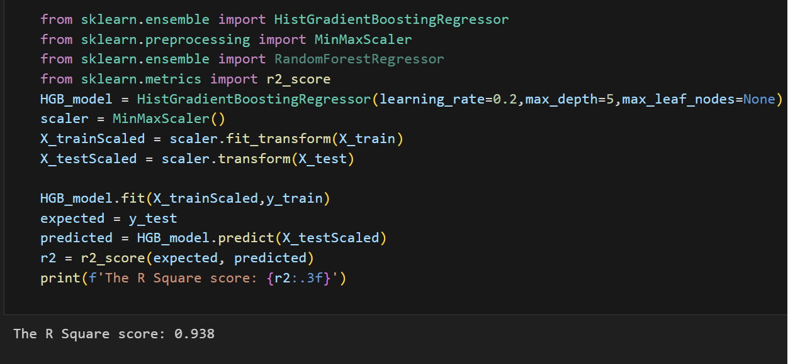
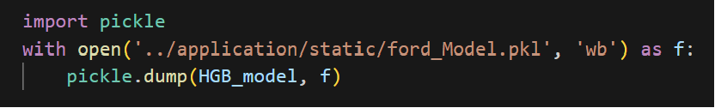
Branch 1 (fordApplication)
We will choose HistGradientBoosting as our final model.
Final Model
Export the model

Slide 14
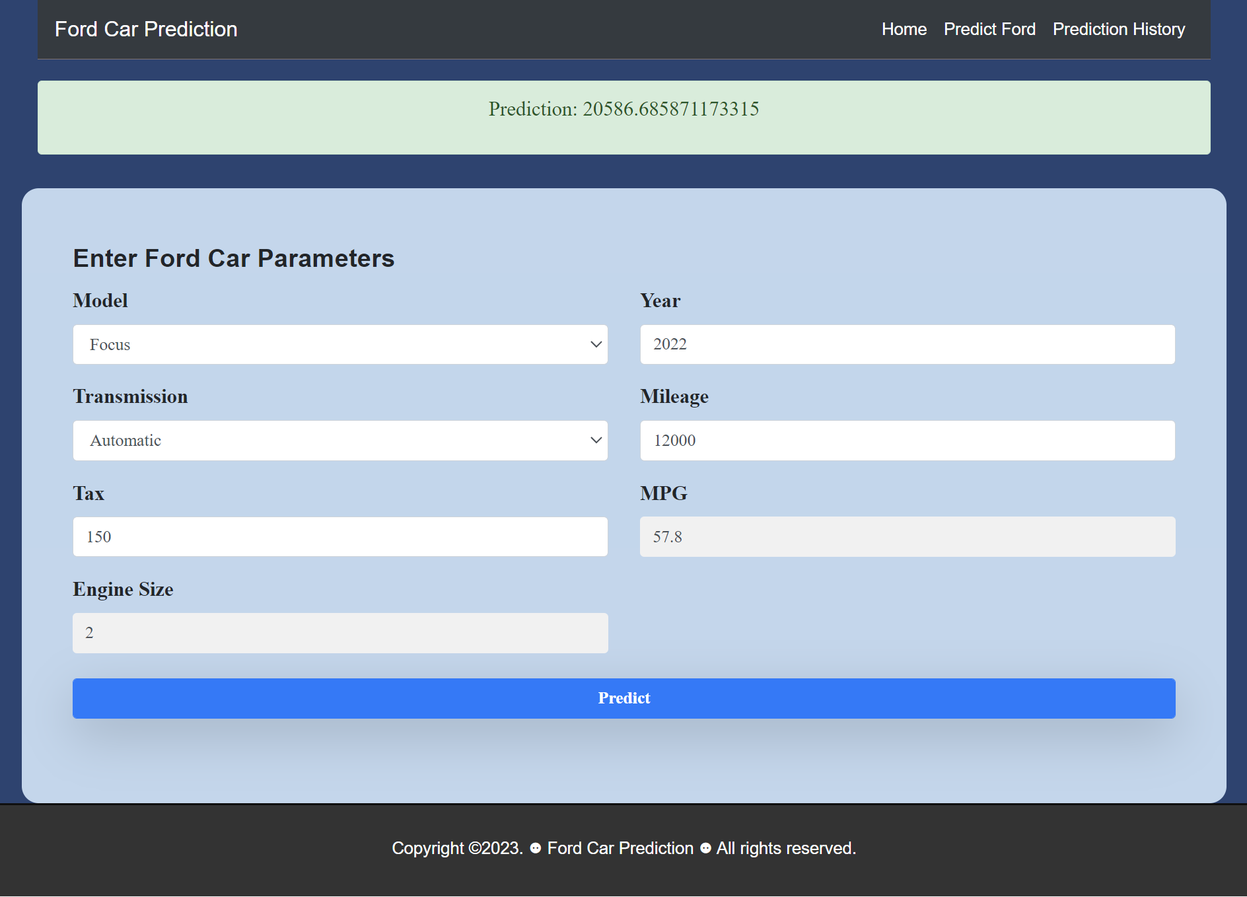
Branch 2 (MLAppDB_branch)
Integrate regression model to web application
Entering prediction parameter through UI

Slide 15
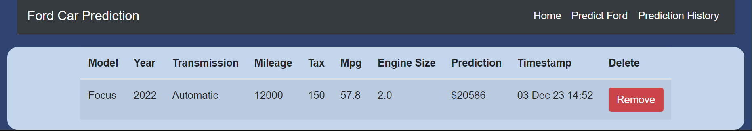
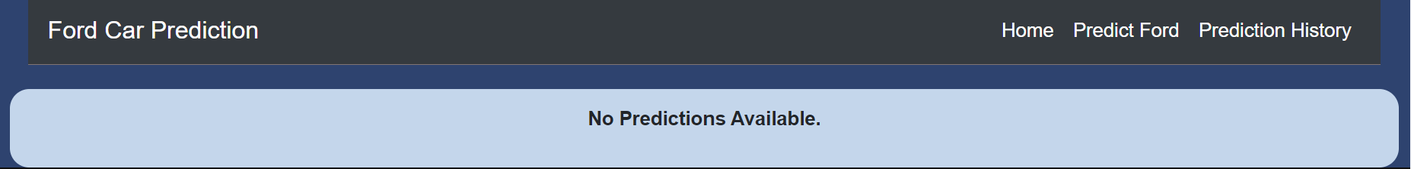
Branch 3 (MLAppHistoryTable_branch)
Storing of prediction through a history table
Predictions are stored in the prediction history table
If there are no predictions made, user will see no predictions available

Slide 16
Branch 3 (MLAppHistoryTable_branch)
Storing of prediction through a history table
Predictions are stored in the prediction history table
If there are no predictions made, user will see no predictions available

Slide 17
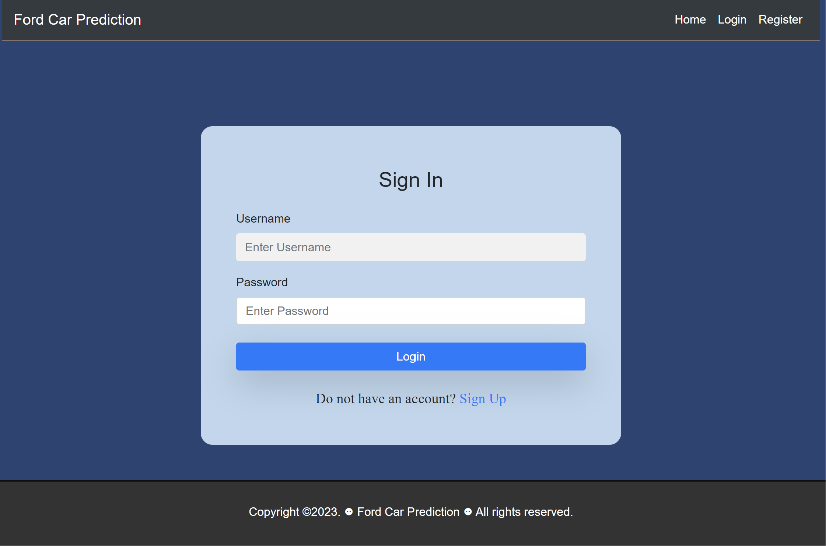
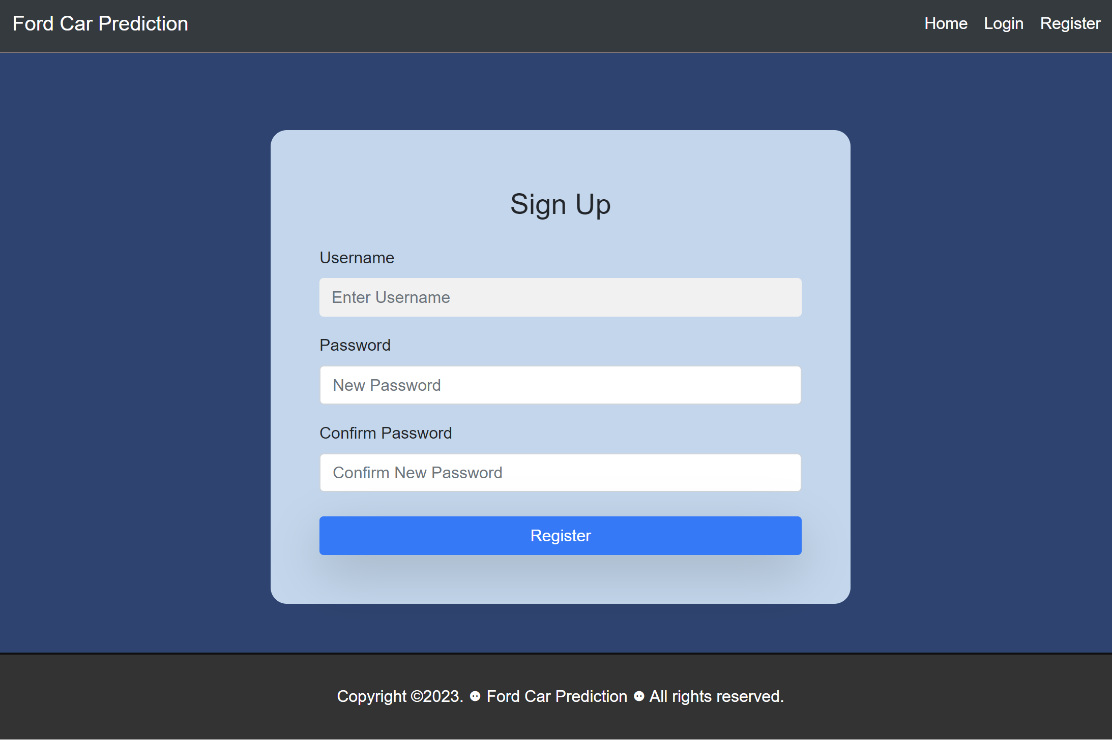
Branch 4 (MLAppLogin_branch)
User Authentication and Login Credentials
login.html
register.html

Slide 18
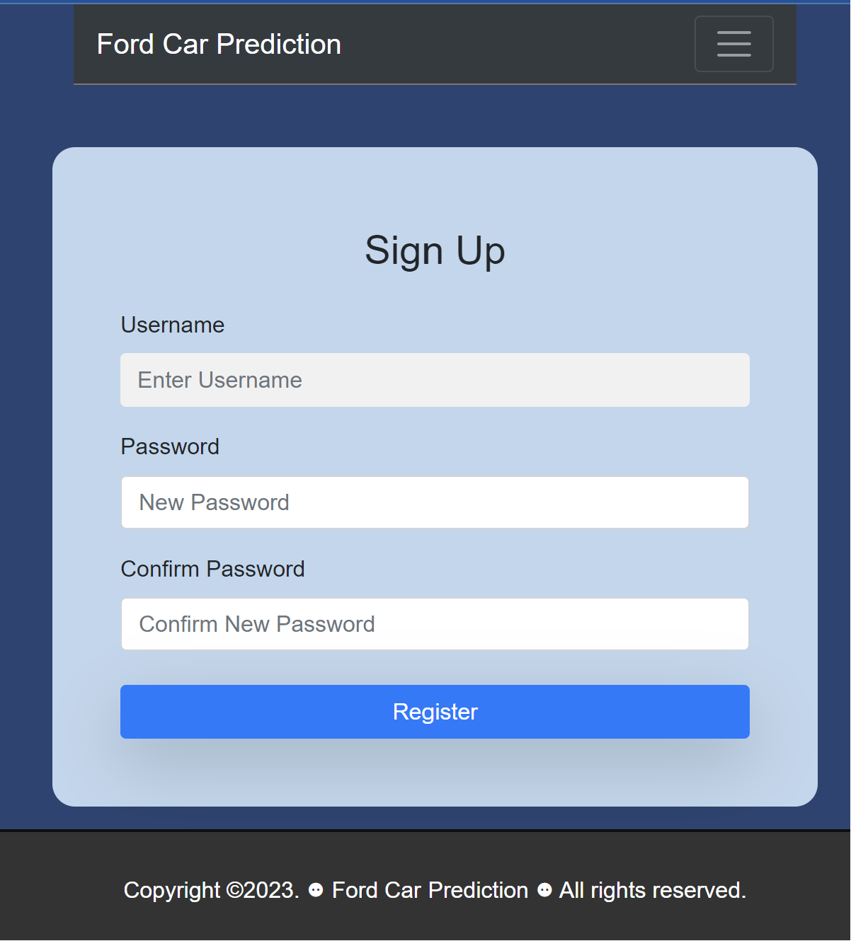
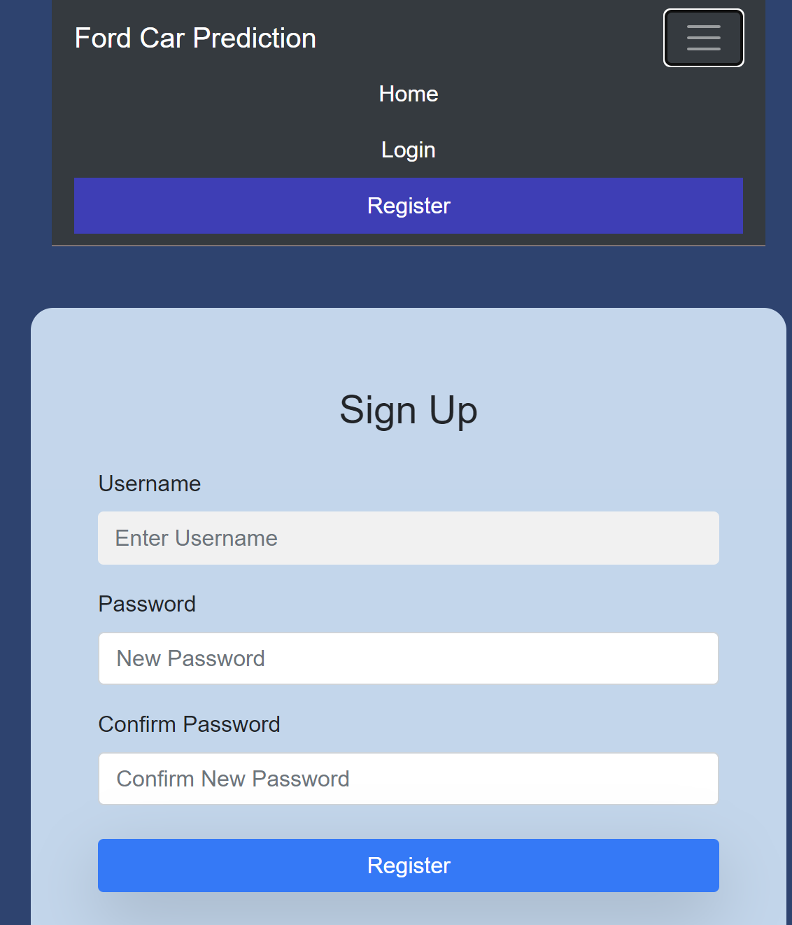
Branch 5 (improveUI)
Responsive Web Application (Catered for smaller and larger devices)
For example: Dropdown menu was added for smaller devices and hover animations

Slide 19
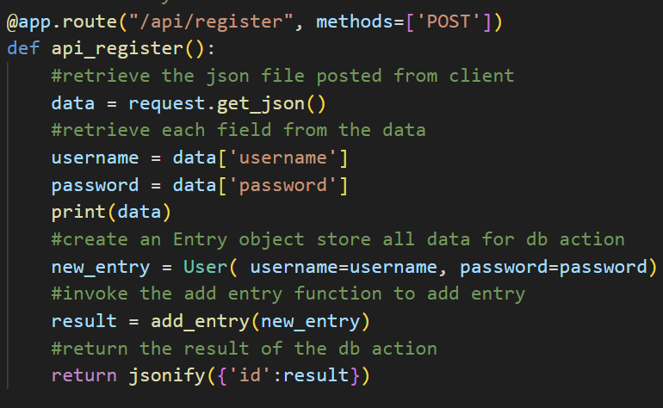
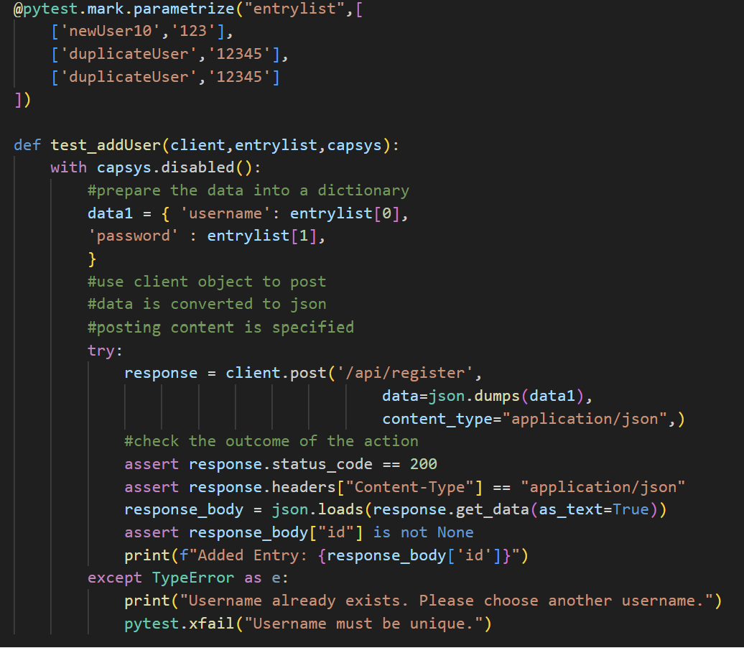
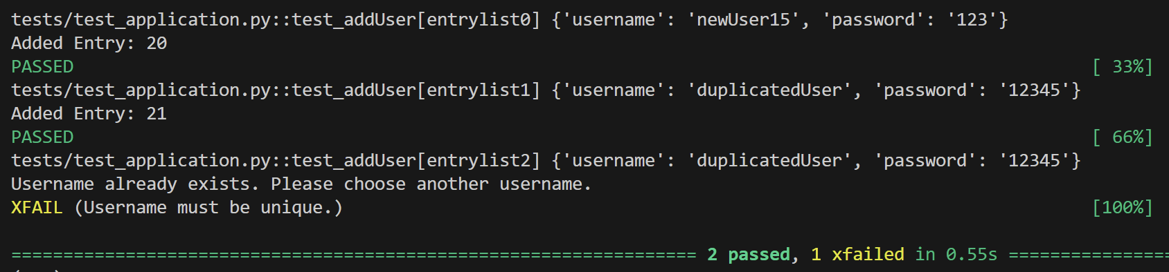
Unit Testing on Web Application
Branch 6 (MLAppPyTest_branch)
Expected Failure and Consistency testing
Registration API Testing
- Passes when unique username is inserted into the database
- Expected failure when username is not unique

Slide 20
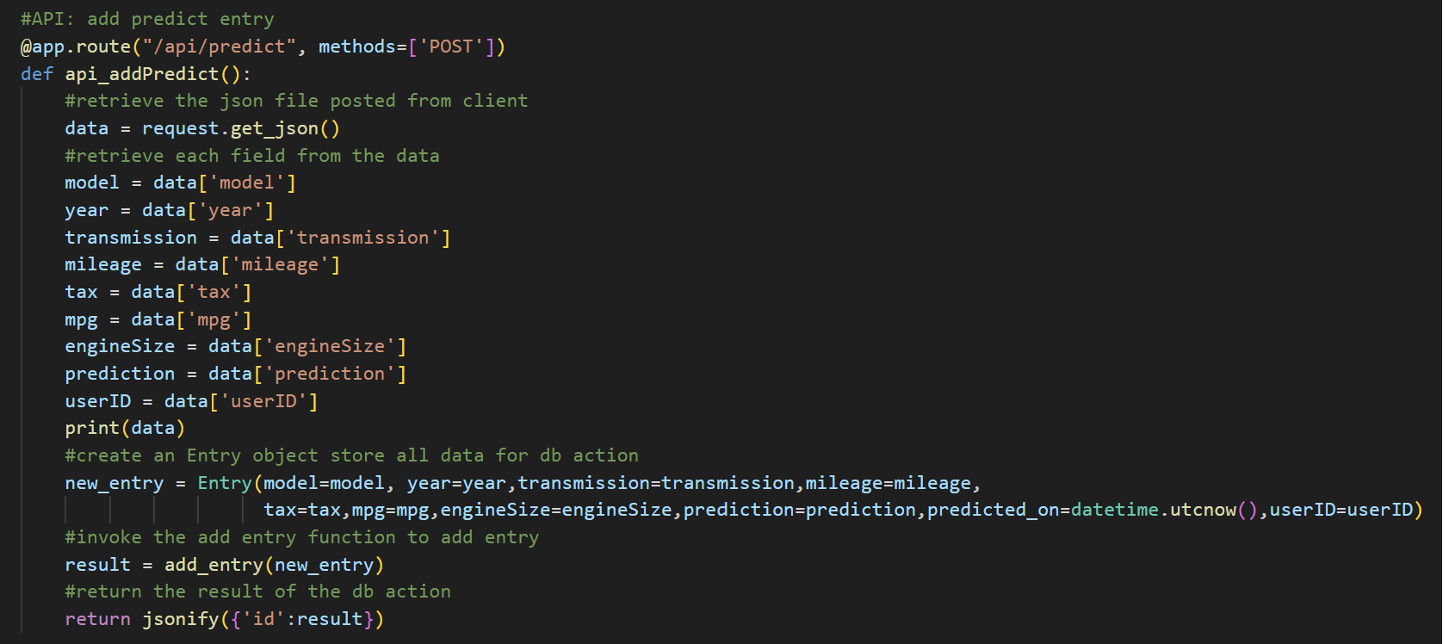
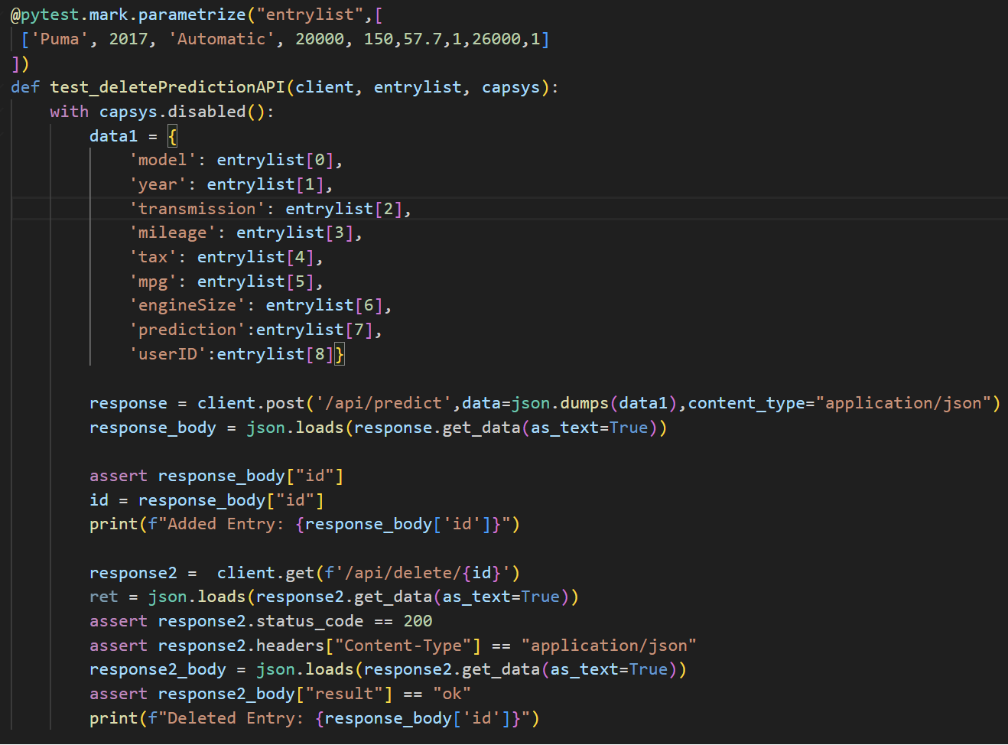
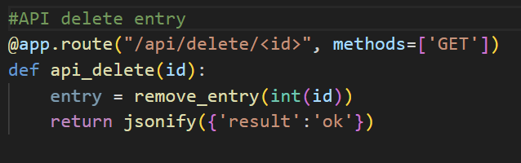
Unit Testing on Web Application
Branch 6 (MLAppPyTest_branch)
Consistency Testing
Testing adding prediction API in prediction history

Slide 21
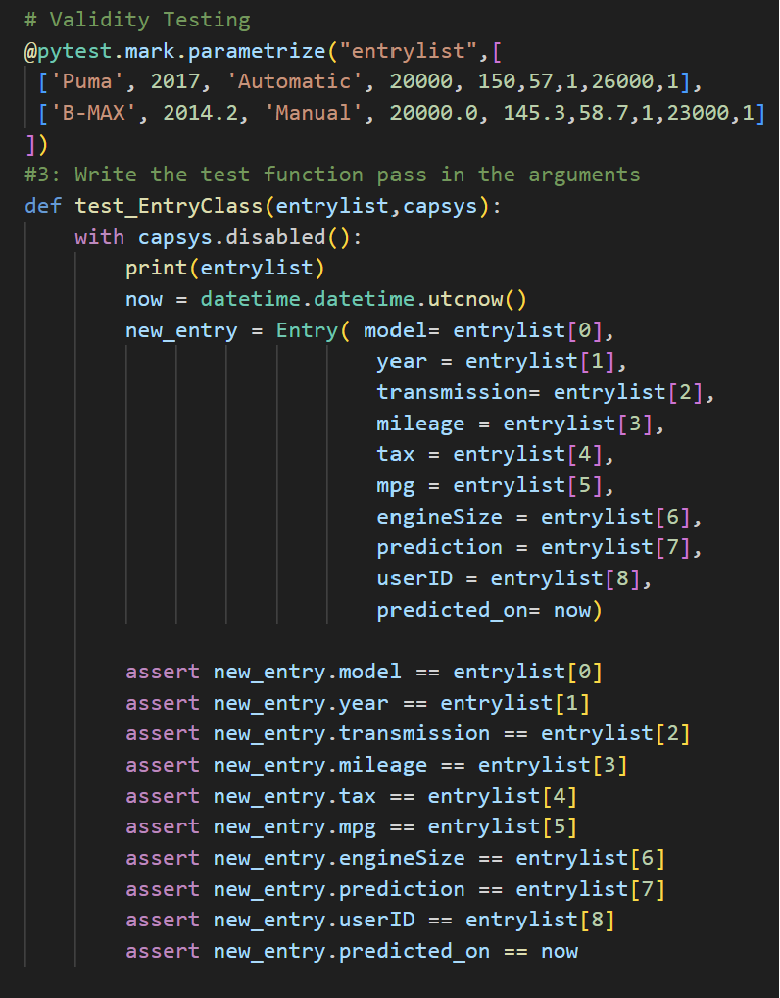
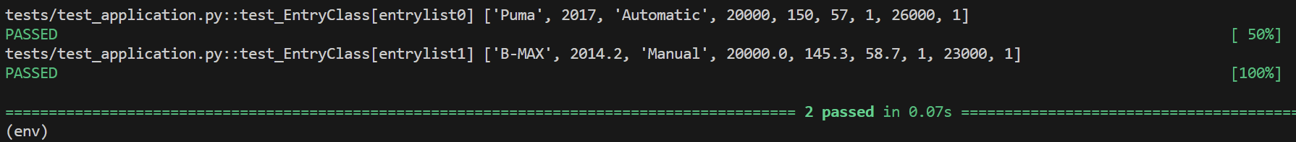
Unit Testing on Web Application
Branch 6 (MLAppPyTest_branch)
Validity Testing
Testing to ensure Entry class can be instantiated with the given attributes. The test is deemed successful when all assertion are passed.

Slide 22
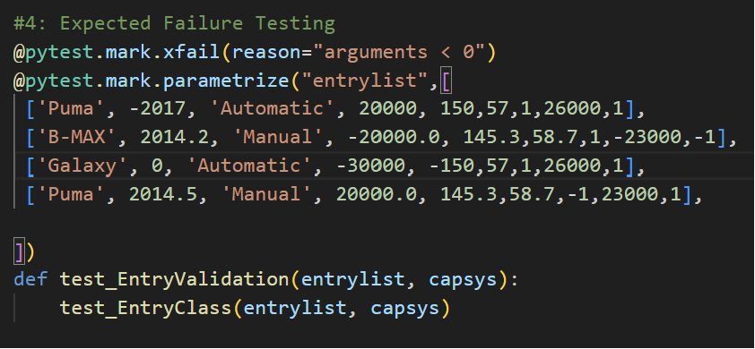
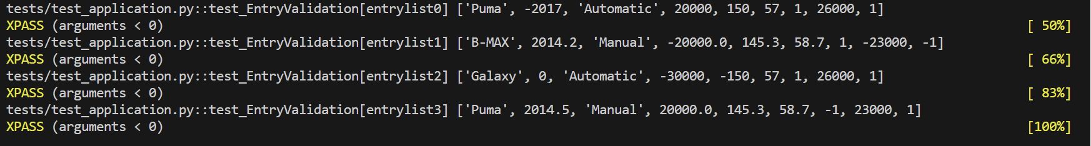
Unit Testing on Web Application
Branch 6 (MLAppPyTest_branch)
Expected Failure Testing
Testing to ensure that the form is able to handle negative values.

Slide 23
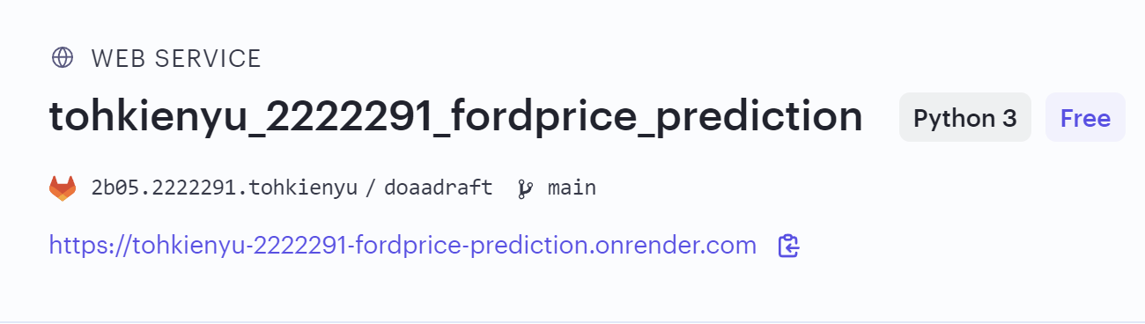
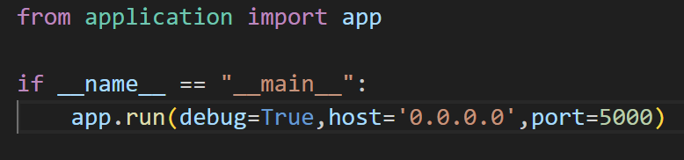

Internet Deployment
Render was used to deploy the web application
app.py

Slide 24

Internet Deployment
Webpage is now accessible on the internet

Slide 25
Thank You

